Slide 1
Basics of Geometry
Geometry
Chapter 1
Notes:
Geometry 1

Slide 2
This Slideshow was developed to accompany the textbook
  Big Ideas Geometry
  By Larson and Boswell
  2022 K12 (National Geographic/Cengage)
Some examples and diagrams are taken from the textbook.
Slides created by
Richard Wright, Andrews Academy
rwright@andrews.edu

Slide 3
1.1 Points, Lines, and Planes
Objectives: By the end of the lesson,
I can describe a point, a line, and a plane.
I can define and name segments and rays.
I can sketch intersections of lines and planes.

Slide 4
1.1 Points, Lines, and Planes
What is it?
What is it like?
Undefined Term
Dot
No Dimension
Point A •
Point A
A
How is it named?

Slide 5
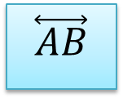
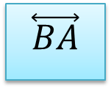
1.1 Points, Lines, and Planes
What is it?
What is it like?
Undefined Term
No Thickness
Goes forever
m
A B
Line • •
Straight
1 Dimension
m
$$\overset{⃡}{AB}$$
$$\overset{⃡}{BA}$$
Through any two points there is exactly one line.
How is it named?

Slide 6

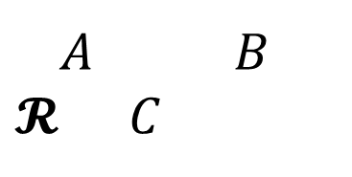
1.1 Points, Lines, and Planes
What is it?
What is it like?
Undefined Term
No Thickness
A B
$𝓡$ C
Goes forever in both directions
Plane • •
•
2 Dimensions
Plane $𝓡$
Plane ABC
Through any three noncollinear points, there is exactly one plane.
How is it named?
Notes:
Book just uses bold capital letter to name a plane.

Slide 7
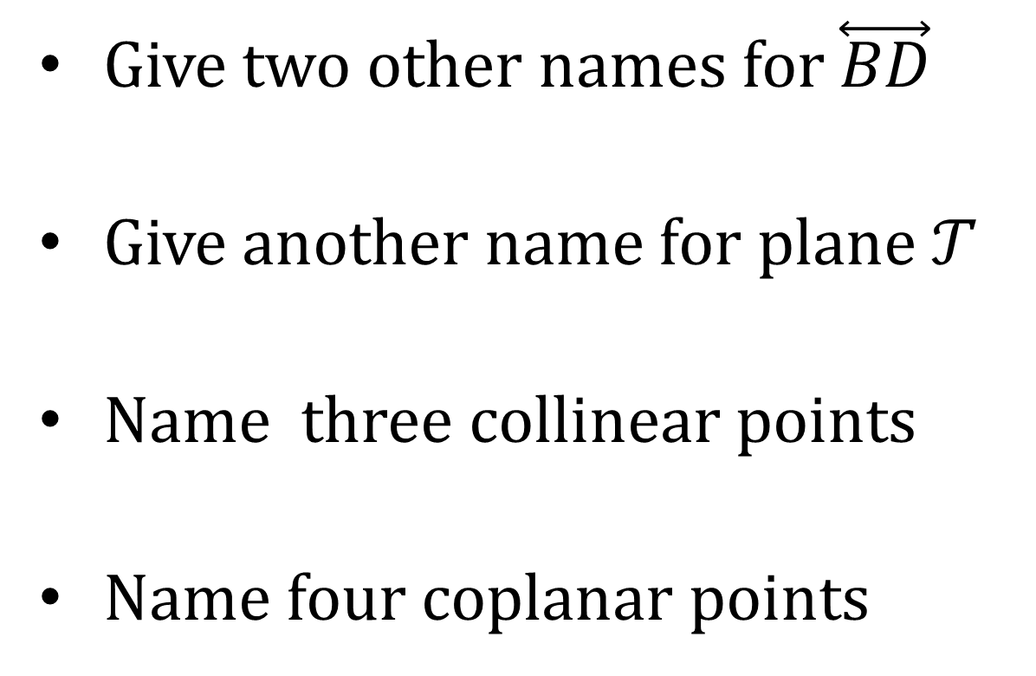

1.1 Points, Lines, and Planes
Give two other names for $\overset{⃡}{BD}$
Give another name for plane $𝒯$
Name three collinear points
Name four coplanar points
ℓ
$$𝒯$$
A
D
B
m
E
C
Notes:
$\overset{⃡}{DB}$, m
Plane ABE
A, B, C
A, B, C, E

Slide 8
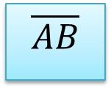
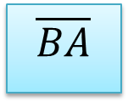
1.1 Points, Lines, and Planes
What is it?
What is it like?
Part of a Line
Part of a line between two endpoints
Segment • •
A B
Does NOT go on forever
Named by endpoints
$$\overline{AB}$$
$$\overline{BA}$$
How is it named?

Slide 9
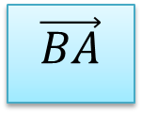
1.1 Points, Lines, and Planes
What is it?
What is it like?
Part of a Line
Part of a line starting at one endpoint and continuing forever
Ray • •
A B
Goes forever in one direction only
Named by endpoint followed by one other point
$$\vec{BA}$$
If two rays have the same endpoint and go in opposite directions, they are called opposite rays.
How is it named?
A
C
B

Slide 10
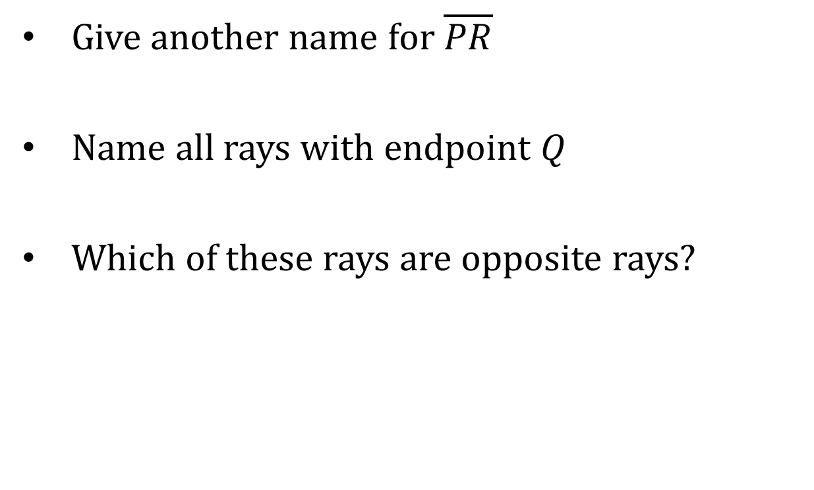
1.1 Points, Lines, and Planes
Give another name for $\overline{PR}$
Name all rays with endpoint Q
Which of these rays are opposite rays?
P
T
Q
R
S
The intersection of two lines is a point.
Notes:
$\overline{RP}$
$\vec{QP}$,$\vec{QR}$,$\vec{QT}$,$\vec{QS}$
$\vec{QT}$ and$\vec{QS}$;$\vec{QP}$ and$\vec{QR}$

Slide 11
1.1 Points, Lines, and Planes
The intersection of two planes is a line.

Slide 12
1.1 Points, Lines, and Planes
Sketch a plane and two intersecting lines that intersect the plane at separate points.
Sketch a plane and two lines that do not intersect lying in the plane.
Sketch a plane and two intersecting lines that lie in the plane.
8 #2, 4, 6, 8, 10, 12, 14, 18, 20, 22, 24, 26, 28, 30, 32, 34, 52, 54, 56, 58

Slide 13
1.2 Measuring and Constructing Segments
Objectives: By the end of the lesson,
• I can measure a line segment.
• I can explain and use the Segment Addition Postulate.

Slide 14
1.2 Measuring and Constructing Segments
Postulate (or Axiom) – Rule that is accepted without proof
Theorem – Rule that is proven
-2
-1
0
1
2
3
4
Ruler Postulate
A
B
Any line can be turned into a number line

Slide 15
1.2 Measuring and Constructing Segments
What is it?
What is it like?
Length measurement
Difference of the coordinates of the points
Distance
AB = | x₂ – x₁ |
AB
BA
-2
-1
0
1
2
3
4
How is it named?
A
B
Find AB
Notes:
$$AB=3−\left(−1 \right)=4$$

Slide 16
1.2 Measuring and Constructing Segments
What is it?
What is it like?
Point Placement
On the segment with the other points as the endpoints
Between
Does not have to be the midpoint
A B C
A B C
What are examples?

Slide 17
1.2 Measuring and Constructing Segments
Segment Addition Postulate
AB
BC
If B is between A and C, then AB + BC = AC
A
B
C
AC
If AB + BC = AC, then B is between A and C
42
Find CD
C
D
17
E
Notes:
$$CD+DE=CE$$
$$CD+17=42$$
$$CD=25$$

Slide 18
1.2 Measuring and Constructing Segments
Graph X(−2, −5) and Y(−2, 3).
Find XY.
Notes:
$$XY=3−(−5)=8$$

Slide 19
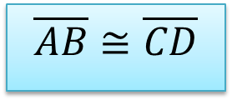
1.2 Measuring and Constructing Segments
What is it?
What is it like?
Comparing shapes
Segments with same length
Congruent Segment
≅ means segments are exactly alike
= means lengths are equal
A
B
$$\overline{AB}≅\overline{CD}$$
C
D
What are examples?
16 #2, 4, 8, 10, 12, 14, 16, 18, 20, 22, 24, 26, 28, 30, 34, 38, 40, 41, 46, 48

Slide 20
1.3 Using Midpoint and Distance Formulas
Objectives: By the end of the lesson,
• I can find lengths of segments.
• I can find the midpoint of a segment.

Slide 21
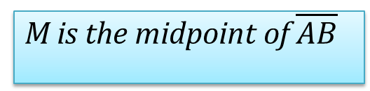
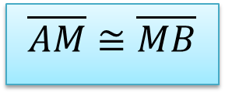
1.3 Using Midpoint and Distance Formulas
What is it?
What is it like?
Part of a Segment
Very middle of the segment
Point that divides the segment into two congruent segments.
Midpoint
A
M
B
M is the midpoint of $\overline{AB}$
$$\overline{AM}≅\overline{MB}$$
AM = MB
What are some examples?
Segment Bisector is something that intersects a segment at its midpoint.

Slide 22

1.3 Using Midpoint and Distance Formulas
$\overline{MO}$ bisects $\overline{NP}$ at Q. If PQ = 22.6, find PN.
Point S is the midpoint of $\overline{RT}$. Find ST.
N
M
Q
O
P
R
S
T
5x − 2
3x + 8
Notes:
$$PQ=\frac{1}{2}PN$$
$$22.6=\frac{1}{2}PN$$
$$PN=45.2$$
$$5x−2=3x+8$$
$$2x−2=8$$
$$2x=10$$
$$x=5$$
$$ST=3(5)+8=23$$

Slide 23
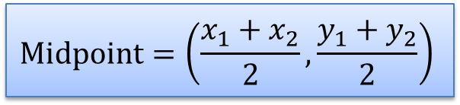
1.3 Using Midpoint and Distance Formulas
Midpoint Formula
$$\text{Midpoint}=\left(\frac{x_{1}+x_{2}}{2},\frac{y_{1}+y_{2}}{2}\right)$$
Find the midpoint of G(7, −2) and H(−5, −6)
Notes:
$$\left(\frac{7+\left(−5\right)}{2},\frac{−2+\left(−6\right)}{2}\right)=(1, −4)$$

Slide 24

1.3 Using Midpoint and Distance Formulas
The midpoint of $\overline{AB}$ is M(5, 8). One endpoint is A(2, −3). Find the coordinates of endpoint B.
Notes:
$$(5, 8)=\left(\frac{x+2}{2},\frac{y+\left(−3\right)}{2}\right)$$
x-coords: $5=\frac{x+2}{2} → 10=x+2 → x=8$
y-coords: $8=\frac{y−3}{2} → 16=y−3 → y=19$
(8, 19)

Slide 25
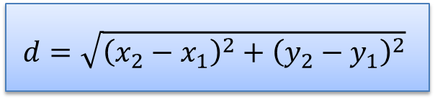
1.3 Using Midpoint and Distance Formulas
Distance Formula
$$d=\sqrt{{\left(x_{2}−x_{1}\right)}^{2}+{\left(y_{2}−y_{1}\right)}^{2}}$$
What is PQ if P(2, 5) and Q(−4, 8)?
24 #2, 4, 6, 8, 14, 16, 18, 20, 22, 24, 26, 28, 30, 32, 34, 44, 46, 48, 50, 59
Notes:
$$PQ=\sqrt{{\left(−4−2\right)}^{2}+{\left(8−5\right)}^{2}}$$
$$PQ=\sqrt{{\left(−6\right)}^{2}+{\left(3\right)}^{2}}$$
$$PQ=\sqrt{36+9}$$
$$PQ=\sqrt{45}=3\sqrt{5}≈6.71$$

Slide 26
1.4 Perimeter and Area in the Coordinate Plane
Objectives: By the end of the lesson,
• I can classify and describe polygons.
• I can find perimeters of polygons in the coordinate plane.
• I can find areas of polygons in the coordinate plane.

Slide 27
1.4 Perimeter and Area in the Coordinate Plane
What happens when you leave the door of the birdcage open?
What is it?
What is it like?
Shape
Sides are straight segments
Polygon
Sides only intersect at ends
Closed shape
No curves
What are examples?
Notes:
You get a Polly gone

Slide 28
1.4 Perimeter and Area in the Coordinate Plane
Convex
All angles poke out of shape.
A line containing a side does NOT go through the middle of the shape.
Concave
Not convex. (There’s a “cave”.)

Slide 29
1.4 Perimeter and Area in the Coordinate Plane
Number of
Type of
sides
Polygon
3
4
3
Triangle
4
Quadrilateral
6
5
Pentagon
6
Hexagon
7
Heptagon
5
10
8
Octagon
9
Nonagon
8
10
Decagon
12
Dodecagon
13
13
-
gon
7
12
n
n
-
gon

Slide 30
1.4 Perimeter and Area in the Coordinate Plane
Classify each polygon by the number of sides. Tell whether it is convex or concave.
Notes:
Pentagon, convex
Dodecagon, concave

Slide 31
1.4 Perimeter and Area in the Coordinate Plane
Perimeter (P)
Distance around a figure
Circumference (C)
Perimeter of a circle
Area (A)
Amount of surface covered by a figure

Slide 32
1.4 Perimeter and Area in the Coordinate Plane
Square
Side s
P = 4s
A = s²
Triangle
sides a, b, c
base b, height h
P = a + b + c
A = ½ bh
a
c
s
h
b
Rectangle
Length ℓ
Width w
P = 2ℓ + 2w
A = ℓw
Circle
diameter d
radius r
C = 2πr
A = πr²
r
ℓ
d
w

Slide 33
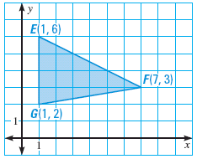

1.4 Perimeter and Area in the Coordinate Plane
Describe how to find the height from F to $\overline{EG}$ in the triangle.
Find the perimeter and area
of the triangle.
Notes:
The height is perpendicular to the base, so it hits EG at (1, 3). Distance from (1, 3) to (7, 3) = 6
Perimeter: find the lengths of each side
EG = 4
$FG=\sqrt{{\left(7−1\right)}^{2}+{\left(3−2\right)}^{2}}=\sqrt{36+1}=\sqrt{37}=6.08$
$EF=\sqrt{{\left(7−1\right)}^{2}+{\left(3−6\right)}^{2}}=\sqrt{36+9}=\sqrt{45}=6.71$
$P=4+6.08+6.71=16.79$
Area: $\frac{1}{2}\left(4\right)\left(6\right)=12$

Slide 34
1.4 Perimeter and Area in the Coordinate Plane
Find the area of ▱ABCD with vertices A(1, 3), B(3, −3), C(−2, −3), and D(−4, 3).
32 #2, 4, 6, 10, 12, 16, 18, 20, 24, 26, 36, 38, 39, 40, 42
Notes:
$$b=3−\left(−2\right)=5$$
$$h=3−\left(−3\right)=6$$
$$A=bh=\left(5\right)\left(6\right)=30$$

Slide 35
1.5 Measuring and Constructing
Angles
Objectives: By the end of the lesson,
• I can measure and classify angles.
• I can find angle measures.

Slide 36
1.5 Measuring and Constructing
Angles
What is it?
What is it like?
Shape
Two rays with common endpoint (vertex)
Angle
Formed when two lines cross
∠BAC
∠CAB
∠A
B
How is it named?
sides
A
C
vertex

Slide 37
1.5 Measuring and Constructing
Angles
Protractor Postulate
A protractor can be used to measure angles
What is it?
What is it like?
Angle measurement
Difference coordinates of each ray on a protractor
Measure
m∠A = |x₂–x₁|
m∠A
m∠BAC
How is it named?

Slide 38
1.5 Measuring and Constructing
Angles
Classifying Angles
  Acute
    Less than 90°
  Right
    90°
  Obtuse
    More than 90°
  Straight
    180°
It’s such a cute angle!

Slide 39
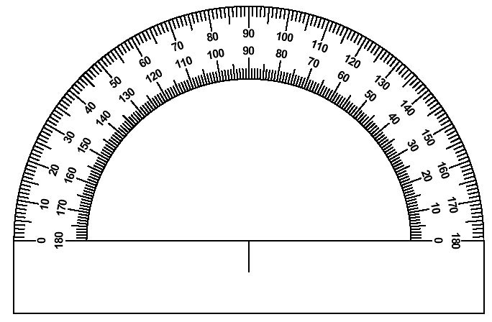
1.5 Measuring and Constructing
Angles
Find the measure of each angle and classify.
  ∠DEC
  ∠DEA
  ∠CEB
  ∠DEB
B
C
A
E
D
Notes:
∠DEC = 90° right
∠DEA = 180° straight
∠CEB = 25° acute
∠DEB = 115° obtuse

Slide 40
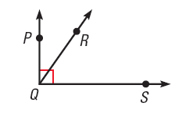
1.5 Measuring and Constructing
Angles
Name all the angles in the diagram.
Which angle is a right angle?
Notes:
∠PQR , ∠PQS, ∠RQS ;
∠PQS is a right angle .

Slide 41
1.5 Measuring and Constructing
Angles
Angle Addition Postulate
If P is in the interior of ∠RST, then
m∠RST = m∠RSP + m∠PST
R
P
If m∠RST = 72°, find m∠RSP and m∠PST
2x – 9
S
3x + 6
T
Notes:
$$2x−9+3x+6=72$$
$$5x−3=72$$
$$5x=75$$
$$x=15$$
$$m∠RSP=2\left(15\right)−9=21°$$
$$m∠PST=3\left(15\right)+6=51°$$

Slide 42
1.5 Measuring and Constructing
Angles
What is it?
What is it like?
Comparing shapes
Angles with same measure
Congruent Angles
≅ means angles are exactly alike
= means measures are equal
∠ABC ≅ ∠DEF
What are examples?

Slide 43
1.5 Measuring and Constructing
Angles
Identify all pairs of congruent angles in the diagram.
In the diagram, m∠PQR = 130°, m∠QRS = 84°, and m∠TSR = 121°. Find the other angle measures in the diagram.
Notes:
∠T ≅ ∠S, ∠P ≅ ∠R
m∠PTS = 121°, m∠QPT = 84°

Slide 44
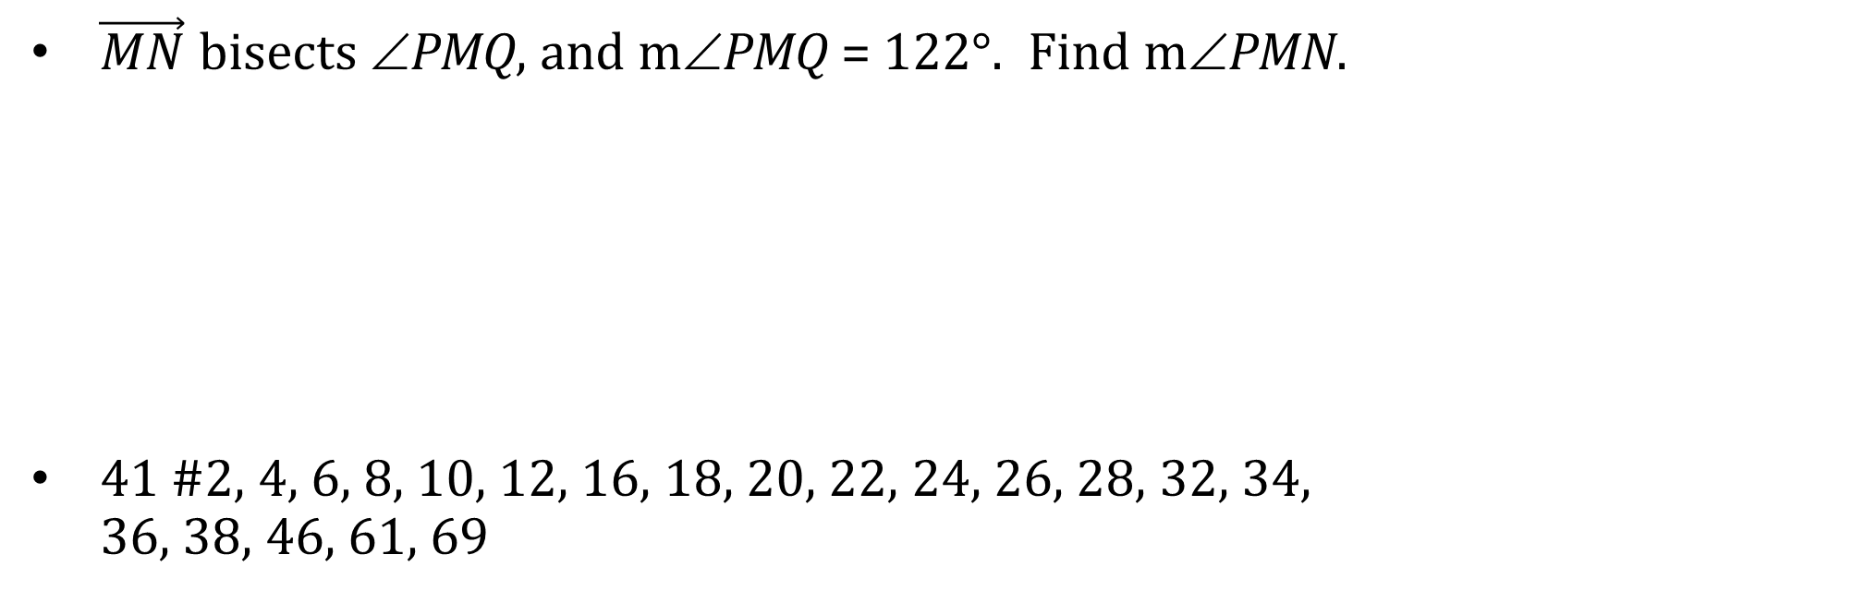
1.5 Measuring and Constructing
Angles
Angle Bisector is a ray that divides an angle into two angles that are congruent.
$\vec{MN}$ bisects ∠PMQ, and m∠PMQ = 122°. Find m∠PMN.
41 #2, 4, 6, 8, 10, 12, 16, 18, 20, 22, 24, 26, 28, 32, 34,
36, 38, 46, 61, 69
N
Q
P
M

Slide 45
1.6 Describing Pairs of Angles
Objectives: By the end of the lesson,
• I can identify complementary and supplementary angles.
• I can identify linear pairs and vertical angles.
• I can fi nd angle measures in pairs of angles.

Slide 46
1.6 Describing Pairs of Angles
What is it?
What is it like?
Angles Pairs
Angles that share a ray and vertex
Adjacent Angles
Are next to each other
Are not inside each other
What are examples?

Slide 47
1.6 Describing Pairs of Angles
Complementary Angles
Two angles whose sum is 90°
Supplementary Angles
Two angles whose sum is 180°
Complementary and Supplementary Angles do not have to be adjacent
Notes:
Both the pairs are supplementary

Slide 48
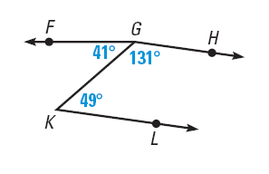
1.6 Describing Pairs of Angles
In the figure, name a pair of
  complementary
  angles,
  supplementary angles,
  adjacent angles.
Are ∠KGH and ∠LKG adjacent angles?
Are ∠FGK and ∠FGH adjacent angles? Explain.
Notes:
Complementary: ∠FGK and ∠GKL
Supplementary: ∠HGK and ∠GKL
Adjacent: ∠FGK and ∠HGK
No, they do not have a common vertex
No, they are inside of each other

Slide 49
1.6 Describing Pairs of Angles
Given that ∠1 is a complement of ∠2 and m∠2 = 8º, find m∠1.
Given that ∠3 is a supplement of ∠4 and m∠3 = 117º, find m∠4.
Notes:
$$8+x=90 → x=82$$
$$117+y=180→y=63$$

Slide 50
1.6 Describing Pairs of Angles
∠LMN and ∠PQR are complementary angles. Find the measures of the angles if m∠LMN = (4x – 2)º and m∠PQR = (9x + 1)º.
Notes:
$$\left(4x−2\right)+\left(9x+1\right)=90 →13x−1=90 →13x=91 →x=7$$
$$m∠LMN=4\left(7\right)−2=26°$$
$$m∠PQR=9\left(7\right)+1=64°$$

Slide 51
1.6 Describing Pairs of Angles
What is it?
What is it like?
Angles Pairs
Angles that make a line
Linear Pair
Linear Pair
Adjacent angles
What are examples?

Slide 52
1.6 Describing Pairs of Angles
What is it?
What is it like?
Angles Pairs
Angles formed when 2 line cross
Vertical Angles
On opposite sides of the intersection
Are not necessarily above each other
What are examples?
Vertical Angles are congruent.

Slide 53
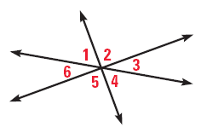
1.6 Describing Pairs of Angles
Do any of the numbered angles in the diagram below form a linear pair?
Which angles are vertical angles?
Notes:
No, no 2 of them form straight lines
∠1 and ∠4, ∠2 and ∠5, ∠3 and ∠6

Slide 54
1.6 Describing Pairs of Angles
Two angles form a linear pair. The measure of one angle is 3 times the measure of the other. Find the measure of each angle.
Notes:
$x+3x=180 → 4x=180 → x=45$ → angles are 45 and 135

Slide 55
1.6 Describing Pairs of Angles
Things you can assume in diagrams.
  Points are coplanar
  Intersections
  Lines are straight
  Betweenness
Things you cannot assume in diagrams
  Congruence unless stated
  Right angles unless stated
50 #2, 4, 6, 8, 10, 12, 14, 16, 20, 22, 24, 26, 28, 40,
42, 51, 52, 53, 54, 62

